Slide 1
CSL505 CRYPTOGRAPHY · TERM PAPER
MANTIS
A Low-Latency Tweakable Block Cipher
Design, Analysis & a Novel Variant
Agastya Nath · Swarnadip Kar · Divyansh Dubey
Indian Institute of Technology Bhilai · Winter 2026
Block Cipher
Lightweight
Low-Latency
Memory Encryption
α-Reflection
SKINNY / MIDORI

Slide 2
INTRODUCTION
Why MANTIS?
⚡
🔑
🔁
The Latency Problem
Tweak Input Needed
Decryption Overhead
AES (10 rounds) is too slow for cache-line memory encryption — every read/write must be protected within a single clock cycle.
PRESENT & SIMON reduce gate count but lack a tweak input for sector-level data isolation. Standard ciphers require costly re-keying.
Separate decrypt circuits double hardware cost. PRINCE introduced α-reflection; MANTIS extends this with a full 64-bit tweak.
MANTIS proposed by Beierle et al. at CRYPTO 2016 as part of the SKINNY cipher family [BJK+16]

Slide 3
THE CIPHER
MANTIS Parameters
Parameter | Value
Block size n | 64 bits
Key size | 128 bits (k₀ ∥ k₁, each 64 bits)
Tweak size | 64 bits
Half-round count r | 5 (MANTIS5) to 8 (MANTIS8)
Cell size | 4 bits (nibble)
State layout | 4 × 4 array of nibbles (row-wise)
Decryption overhead | Zero — same circuit, swapped keys
Key Schedule
k′₀ = ROR64(k₀, 1)
k̄₁ = k₁ ⊕ α
α = 0x243F6A88
85A308D3
(from π digits)
FX-Construction
Pre- and post-whitening keys k₀ and k′₀ wrap the keyed permutation, boosting security of the inner cipher.
α-Reflection: Dec(k₀,k′₀,k₁)(·,T) = Enc(k′₀,k₀,k₁⊕α)(·,T) — Decryption is free hardware!

Slide 4
CIPHER COMPONENTS
S-Box · PermuteCells · MixColumns
Involutory MIDORI S-Box Sb₀
Sb₀ ∘ Sb₀ = id (same table for encrypt & decrypt)
x | 0 | 1 | 2 | 3 | 4 | 5 | 6 | 7 | 8 | 9 | A | B | C | D | E | F
Sb₀ | C | A | D | 3 | E | B | F | 7 | 8 | 9 | 1 | 5 | 0 | 2 | 4 | 6
DPmax = 2⁻² · εmax = 2⁻² (optimal for involutory 4-bit S-boxes)
PermuteCells (MIDORI P)
MixColumns (Involutory)
Permutes 16 nibbles of the 4×4 state array.
Maximises active S-boxes vs PRINCE permutation.
Binary matrix M over GF(2), applied per column.
M² = I → same circuit for encrypt & decrypt.
P: 0→0 1→11 2→6 3→13 4→10 5→1 6→12 7→7
8→5 9→14 10→3 11→8 12→15 13→4 14→9 15→2
M = | 0 1 1 1 | Branch number 4
| 1 0 1 1 | M² = I (involutory)
| 1 1 0 1 |
| 1 1 1 0 |

Slide 5
ROUND FUNCTION & ENCRYPTION
MANTISᵣ Encryption Algorithm
1
SubCells
Apply Sb₀ to each of 16 nibbles
Full Encryption
s ← m ⊕ k₀ ⊕ k₁ ⊕ T
2
AddConstant
XOR state with round constant RCᵢ
(initial whitening)
Forward half Hᵣ:
for i=1..r:
3
AddTweakey
XOR state with hⁱ(T) ⊕ k₁
SubCells → AddRC → AddTK
→ PermCells → MixCols
SubCells(s)
4
PermuteCells
Apply permutation P to nibble positions
Middle layer:
M(s) → SubCells(s)
Backward half H⁻¹ᵣ:
5
MixColumns
Multiply each column by matrix M over GF(2)
for i=r..1:
MixCols → P⁻¹ → AddTK
→ AddRC → SubCells
c ← s ⊕ k′₀ ⊕ k₁ ⊕ α ⊕ T

Slide 6
ROUND CONSTANTS
Fixed from π · RC₁ – RC₈
RC1
0x13198A2E03707344
RC2
0xA4093822299F31D0
RC3
0x082EFA98EC4E6C89
RC4
0x452821E638D01377
RC5
0xBE5466CF34E90C6C
RC6
0xC0AC29B7C97C50DD
RC7
0x3F84D5B5B5470917
RC8
0x9216D5D98979FB1B
α = 0x243F6A8885A308D3 (used to form k̄₁ = k₁ ⊕ α, also derived from π)

Slide 7
TWEAK SCHEDULE
64-bit Tweak Permutation h
h = [6, 5, 14, 15, 0, 1, 2, 3, 7, 12, 13, 4, 8, 9, 10, 11]
Action: h(T)[i] = T[h[i]]
Round Usage
No GF Multiplications
Chosen by MILP
Precomputed sequence h¹(T), h²(T), …, hʳ(T)
used in rounds 1, 2, …, r respectively.
Pure nibble permutation — no Galois-field arithmetic required, keeping the tweak schedule lightweight.
Permutation h was selected by exhaustive MILP search over 8! candidates to maximise security.
Tweak Security Property
Related-tweak attacks are the primary threat. MILP verified that MANTIS5 admits no related-tweak slide attack with fewer than 2³⁰ chosen plaintext–ciphertext pairs.

Slide 8
OFFICIAL TEST VECTORS
Verified against Appendix B.2 of [BJK+16]
Key (k₀∥k₁): 92F09952C625E3E9 D7A060F714C0292B Tweak: BA912E6F1055FED2
MANTIS5
PT: 3B5C77A4921F9718
CT: D6522035C1C0C6C1
MANTIS6
PT: D6522035C1C0C6C1
CT: 60E43457311936FD
MANTIS7
PT: 60E43457311936FD
CT: 308E8A07F168F517
MANTIS8
PT: 308E8A07F168F517
CT: 971EA01A86B410BB
Each variant's ciphertext is the next variant's plaintext — a chain of cascading test vectors!

Slide 9
PROPOSED NOVEL CIPHER
Two Key Modifications to MANTIS
Fixed round constants and static round-key reuse → predictable differential propagation. Two targeted modifications fix this while preserving MANTIS's lightweight SPN & α-reflection architecture.
① Dynamic Round Constants via LFSR
② Rotating Round-Key Schedule
Feedback polynomial:
Round sub-key generation:
p(x) = x⁶⁴ + x⁴ + x³ + x + 1
RKᵢ = ROR64(K₁, 4i) ⊕ RCᵢ
Primitive over GF(2) → period = 2⁶⁴ − 1
Round tweakey:
Seed derivation:
TKᵢ = hⁱ(T) ⊕ RKᵢ
RC₀ = K₀ ⊕ T
Backward half (α-reflection preserved):
RCᵢ₊₁ = LFSR(RCᵢ)
Tweakey = hⁱ(T) ⊕ (RKᵢ ⊕ α)
R₆₃ · · · R₄ R₃ R₂ R₁ R₀ → ⊕ → feedback
Preserved properties:
Bits 63, 3, 2, 0 XORed for feedback tap
✓ SPN structure unchanged
✓ Tweak permutation unchanged
✓ α-reflection decryption intact

Slide 10
PROPOSED NOVEL CIPHER
Generated Round Keys & Performance
Generated 64-bit Round Keys (8 Forward Rounds)
Performance Benchmark (Python)
K = 92F09952C625E3E9 D7A060F714C0292B · T = BA912E6F1055FED2
Metric | Original | Novel
Total time | 9.165 s | 11.126 s
Avg enc. | 91.65 µs | 111.26 µs
Throughput | 10,910/s | 8,988/s
Overhead | — | 21.39%
Round | Round Key (hex)
1 | 951BB132A73C1FA9
2 | 7B14CE1B5BF4FA5F
3 | 333BA6F156B138EF
4 | 6A266E4ED377FD1A
5 | 8489CEA7610EA2F9
6 | CC1FCC6D6E63507F
7 | 546F5DC8E60141A7
8 | 241BB7C0EFAEFD5A
Round-Key Generation Flow
K₁
ROR64(K₁, 4i)
⊕ RCᵢ
RKᵢ
hⁱ(T)
⊕ RKᵢ
TKᵢ
Note: Python benchmark — actual C/FPGA/ASIC performance would be significantly higher

Slide 11
SECURITY ANALYSIS
Differential Cryptanalysis — DDT & Active S-Boxes
Round-wise Active S-Box Counts (Table 9)
Layer | Original | Novel
FWD_SBOX_1 | 1 | 1
FWD_SBOX_2 | 3 | 3
FWD_SBOX_3 | 9 | 9
FWD_SBOX_4 | 16 | 16
FWD_SBOX_5 | 13 | 16
FWD_SBOX_6 | 15 | 14
FWD_SBOX_7 | 15 | 16
MID_SBOX_1 | 14 | 16
MID_SBOX_2 | 15 | 16
BWD_SBOX_7 | 14 | 15
BWD_SBOX_6 | 13 | 15
BWD_SBOX_5 | 16 | 16
BWD_SBOX_4 | 15 | 16
BWD_SBOX_3 | 14 | 15
BWD_SBOX_2 | 15 | 14
BWD_SBOX_1 | 16 | 15
S-Box DDT & Differential Properties
DDT max nontrivial entry
4
Differential uniformity
4
DPmax(Sb₀) = 4 / 2⁴
2⁻²
Same as original MANTIS
✓ unchanged
Total Active S-Boxes (7-round MANTIS)
Cipher | Active S-Boxes | Trail Bound
Original MANTIS | 204 | ≤ 2⁻⁴⁰⁸
Novel MANTIS | 213 | ≤ 2⁻⁴²⁶

Slide 12
DIFFERENTIAL CRYPTANALYSIS
Avalanche Analysis & Differential Trails
Avalanche Analysis
Differential Trail Probability
Single-bit plaintext flip → measure changed ciphertext bits
Ptrail ≤ (2⁻²)ᴺ where N = total active S-boxes
Metric | Value
Ideal avalanche (64-bit) | 32 bits
Original MANTIS avg | 32.0148 bits
Novel MANTIS avg | 32.0255 bits
Std dev (Original) | 3.9759 bits
Std dev (Novel) | 3.9424 bits
Original (N=204): Ptrail ≤ 2⁻⁴⁰⁸
Novel (N=213): Ptrail ≤ 2⁻⁴²⁶
2-Round Reduced Characteristic
Input differential: ΔP = 0x0000000000000001
Performance Comparison
Round 1 transition 1→2: prob = 2⁻²
Round 2 (3 active S-boxes): (2⁻²)³ = 2⁻⁶
Metric | Original | Novel
Total time | 9.165 s | 11.126 s
Avg enc. time | 91.65 µs | 111.26 µs
Throughput | 10,910 /s | 8,988 /s
Overhead | — | 21.39%
P₂-round ≈ 2⁻⁸ → Data: ~2⁸ pairs, Time: ~2⁹ ops
Representative 7-Round Trail (FWD layers)
Orig: 1→3→9→16→13→15→15 active S-boxes
Novel: 1→3→9→16→16→14→16 active S-boxes

Slide 13
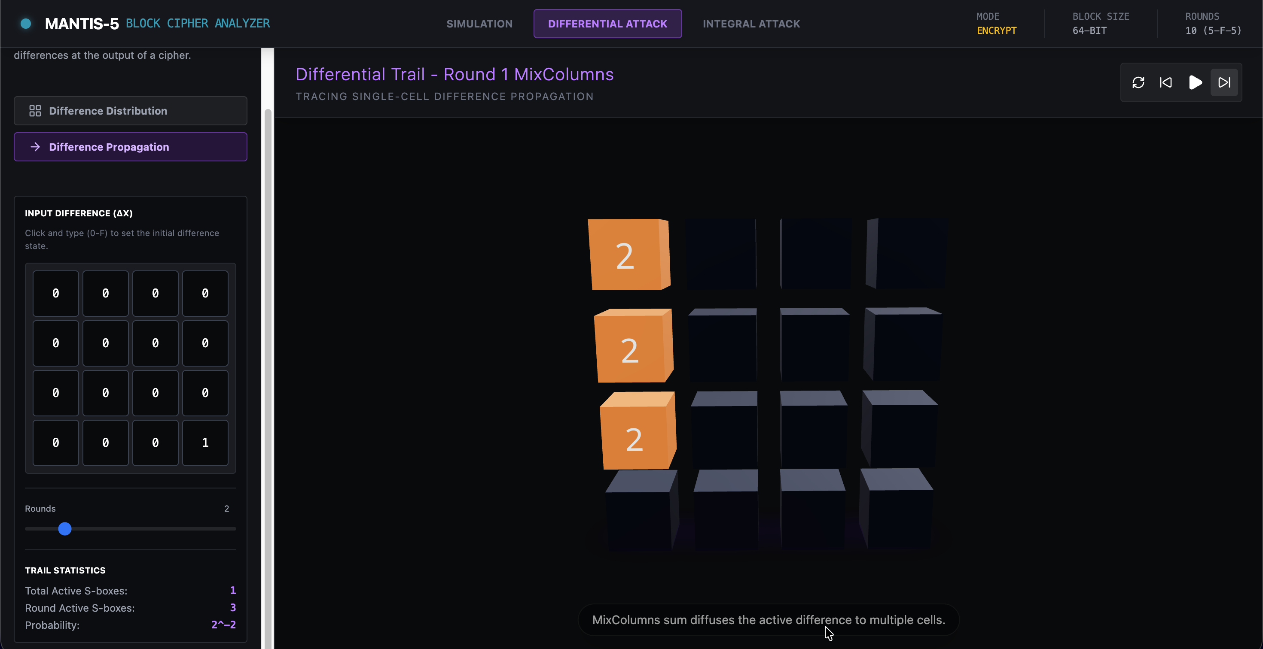

Slide 14
SECURITY ANALYSIS
Integral Cryptanalysis on MANTIS5
A
Active
C
Constant
B
Balanced
U
Unknown
Nibble takes all 16 values exactly once
Nibble is fixed across all plaintexts
XOR sum of nibble values = 0
No predictable algebraic property
5-Round Attack Strategy
Complexity Summary
Phase 1 – Distinguisher (Rounds 1–4):
16 chosen plaintexts (1 active nibble). After 4 rounds → balanced nibbles appear. Propagation: A → 3A+C → multiple A → B
Phase 2 – Key Recovery (Round 5):
Partially decrypt from ciphertext side.
Guess 4×4 = 16 key bits per column.
Check balanced property holds.
Metric | Value
Data | 2⁶ chosen plaintexts
Time | 2¹⁹·⁷ equiv. encryptions
Memory | 2¹⁰ MANTIS states
Key bits guessed | 16 (vs 64 exhaustive)

Slide 15
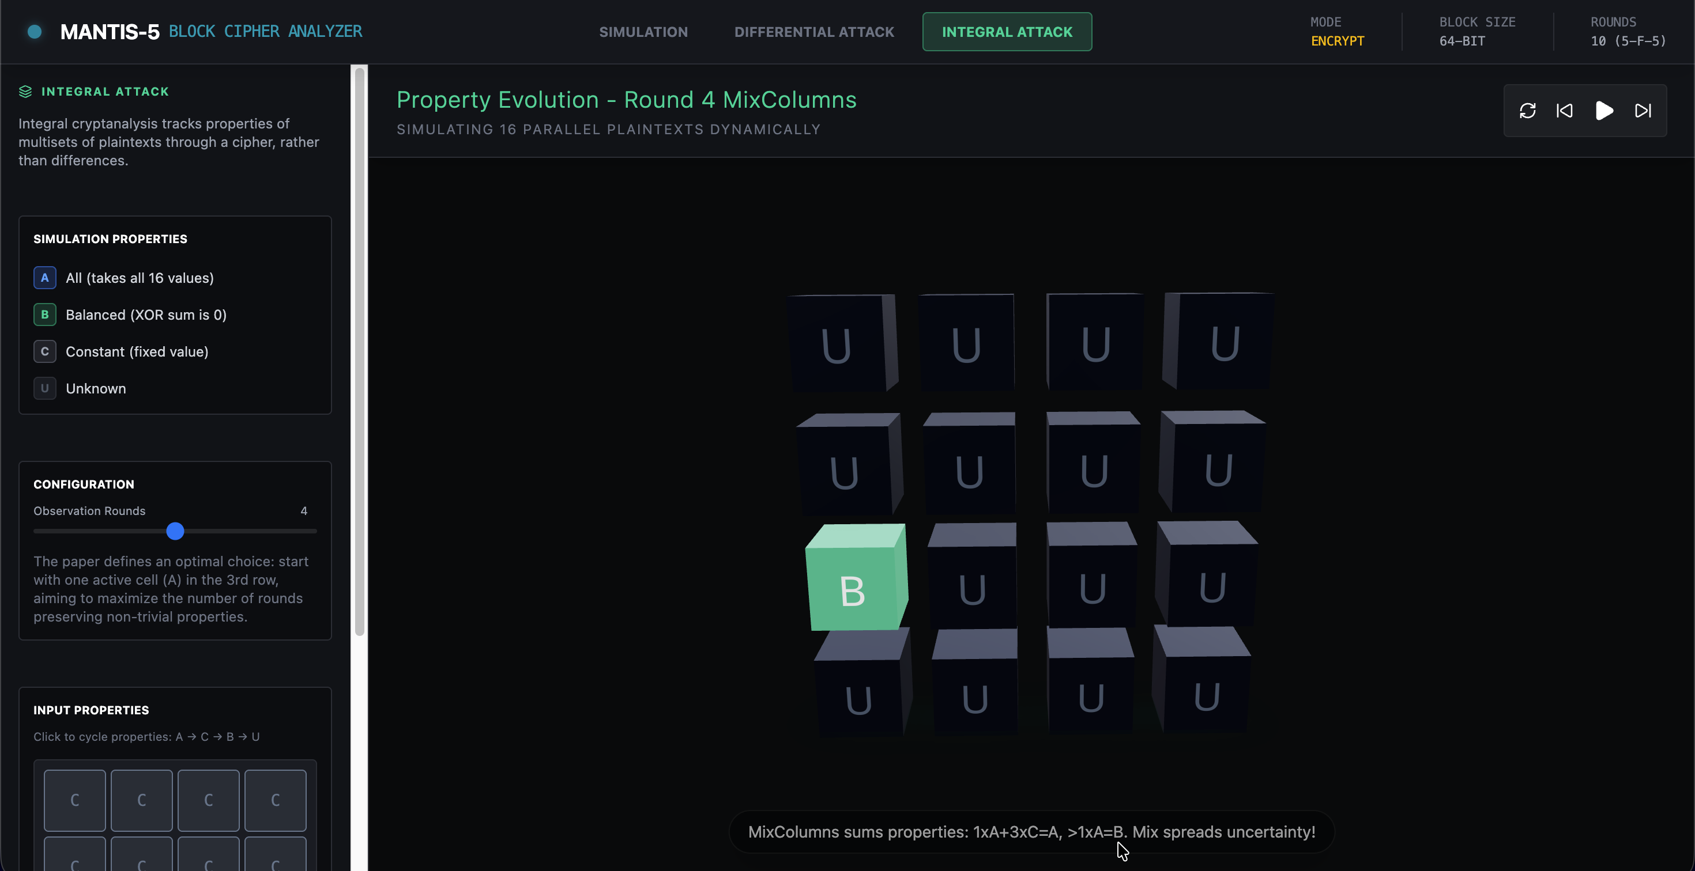

Slide 16
⭐ BROWNIE POINTS
Mantis Cipher Explorer
An interactive 3D simulation & analysis tool for the MANTIS block cipher
🌐 Live Demo:
mantis-cipher-explorer.vercel.app
💻 Source Code:
github.com/Swarnadip-Kar/mantis-cipher-explorer
🎲
Interactive 3D Simulation
🔐
Cryptographic Accuracy
⚙️
Configurable Parameters
Step-by-step 3D viz of cipher state matrix (encryption & decryption) built with React & React Three Fiber.
Strictly follows MANTIS spec — SubCells, MixColumns, AddTweakey, ShuffleCells, all 4 official test vectors verified.
MANTIS-5 through MANTIS-8 and beyond. Customizable Plaintext, Key₀, Key₁, Tweak via control panel.
🔍
Differential Attack Analysis
📊
Integral Attack Analysis
🌟
Premium UI/UX
Inject XOR diff Δin, observe propagation, highlight active cells, display Δout after each round.
16-plaintext structure sweeps one nibble. XOR sum tracked round-by-round until balanced property vanishes.
Dark-themed, Framer Motion animations, detailed operation tracking. React 19 + Tailwind CSS + Drei.

Slide 17
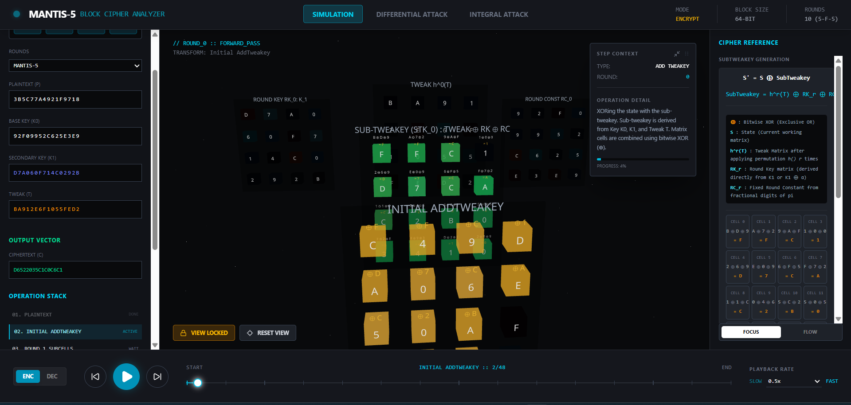

Slide 18
NOVEL VARIANT
Key–Tweak-Seeded Round Schedule
LFSR-Based Round Constants
Key-Dependent Sub-Keys
Arbitrary Round Counts
Seed: r₀ = k₀ ⊕ T
Sequence: rᵢ = LFSR(rᵢ₋₁)
LFSR(x) = (x≪1) ⊕ feedback(bits 63,3,2,0)
Replaces fixed RC₁…RCᵣ with key- and tweak-dependent values.
Round i sub-key:
rkᵢ = ROR64(k₁, 4i) ⊕ rᵢ₋₁
Forward tweakey: hⁱ(T) ⊕ rkᵢ
Backward tweakey: hⁱ(T) ⊕ (rkᵢ ⊕ α)
Preserves α-reflection decryption structure.
Base MANTIS: r ∈ {5,6,7,8} only
Novel variant: any r ≥ 1
Tested: r = 5, 9, 12, 27
Enables exploration of security–latency trade-offs beyond the original design space.
Novel Variant Test Vectors (same Key & Tweak as official)
r | Plaintext | Ciphertext
5 | 3B5C77A4921F9718 | 141783D63FCB272E
9 | D6522035C1C0C6C1 | 708B16A570A23941
12 | 60E43457311936FD | 83E42E3E42681D75
27 | 308E8A07F168F517 | 108AF35E94342A33

Slide 19
APPLICATIONS
Where MANTIS Shines
🖥️
📡
🏷️
Memory Encryption
IoT & Embedded Systems
vs PRESENT / AES
Primary use case — IBM SecureBlue++, Intel SGX. Every cache-line read/write encrypted on the critical path. Memory address serves as the tweak, providing natural sector isolation without IV management overhead.
MANTIS5 requires only 8,544 GE at 15.95 ns (UMC 180 nm). Marginal area over PRINCE while gaining a full tweak input. Ideal for sensor-address binding in embedded deployments.
PRESENT (ISO/IEC 29192-2) targets passive RFID (1,570 GE). AES dominates general-purpose usage. MANTIS fills the gap: active processors needing low-latency decryption with tweak support.
✓ Single-cycle latency
✓ 8,544 GE gate count
✓ Active processor niche
✓ Zero decrypt overhead
✓ 15.95 ns latency
✓ Tweak beats PRESENT
✓ Tweak = memory address
✓ Tweak binds sensor ID
✓ Better latency than AES

Slide 20
CONCLUSION
Summary & Takeaways
✅
Complete MANTISᵣ specification: S-box, PermuteCells, MixColumns, tweak schedule, FX-construction key schedule.
✅
Worked example for MANTIS5 verified against official test vectors [BJK+16]; MANTIS6–8 also confirmed.
✅
Differential analysis: DDT, active S-boxes (orig 204 vs novel 213), avalanche ~32 bits, trail prob ≤ 2⁻⁴²⁶ (novel).
✅
Integral distinguisher (2⁶ data, 2¹⁹·⁷ time, 2¹⁰ memory) on 5-round MANTIS. 3 structural weaknesses noted.
⭐
Novel variant: LFSR-seeded constants + rotation sub-keys + arbitrary r ≥ 1 · Cipher Explorer deployed at vercel.app
🌐
MANTIS = best balance of latency, area, and tweakability for active-processor memory encryption.
CSL505 Cryptography · IIT Bhilai · Winter 2026

